Slide 1
5G TECHNOLOGIES
PRESENTED BY,
KOKKIRALA ABHINAV
KOLLI VENKATANAGA PAVAN
MERAVATH PAVAN KUMAR
MALLAVARAPU ABHISHITH

Slide 2
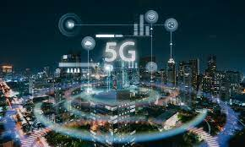
WHAT IS 5G?
5G Means 5th Generation Mobile Network. It is a new global wireless standard after1G,2G,3G and 4G networks.
5G enables a new kind of network that is designed to connect virtually to every one and everything together including machines ,objects and devices.
5th Generation has Complete wireless communication with almost no limitations.
Has incredible transmission speed.
More phone & features in hand held phones.

Slide 3
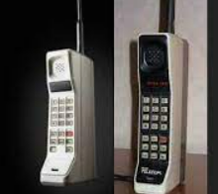
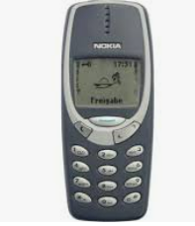
Evolution of 1G—5G
1st Generation:
Developed in 1980’s.
Speed up to 2.4 kbps.
Allows user to make voice calls in one country
2nd Generation:
Developed in 1990’s.
Speed up to 64 kbps.
Services such are digital voice and sms with more clarity & Semi global facility.

Slide 4
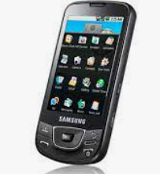
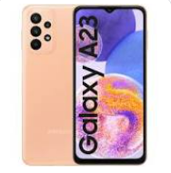
3rd Generation:
Developed in 2001.
Speed up to 125kbps t0 2mbps.
First time Internet is used in this 3G technology like E-mail, online shopping, Banking, etc.
4th Generation:
Developed in 2010.
Speed up to 100mbps.
Faster & More Reliable, High performance, Easy Roaming, Low cost, etc.

Slide 5
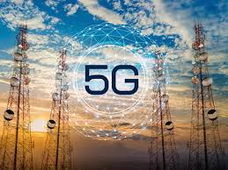
5th Generation:
Developed in year 2019.
Next major phase of mobile telecommunication & wireless system.
10times more capacity than others technologies.
Expected speed up to 1Gbps.
More faster, reliable &Lower cost that previous Generations.

Slide 6
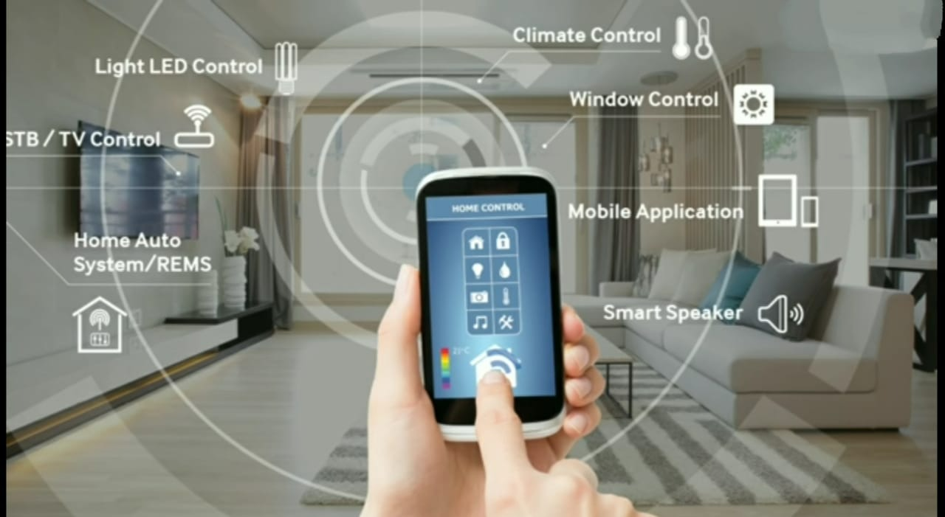
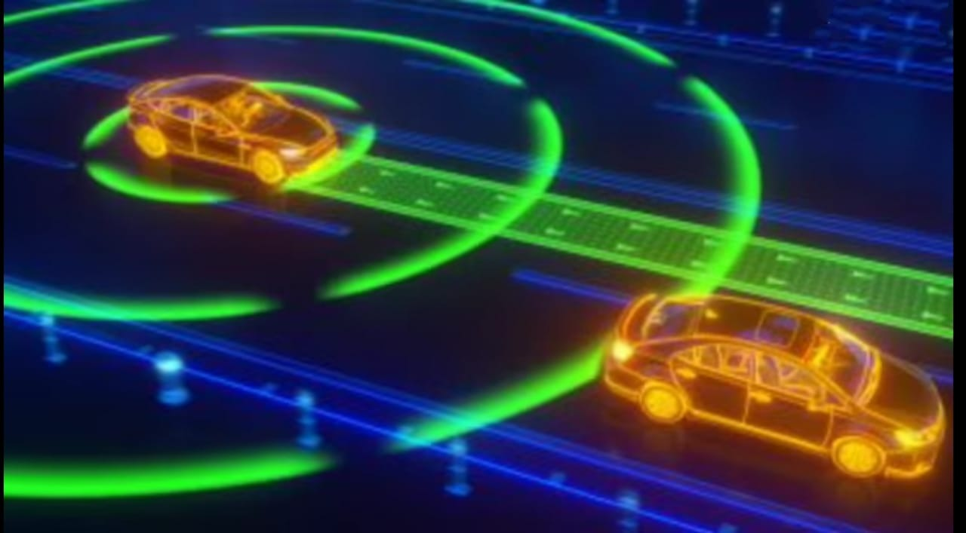
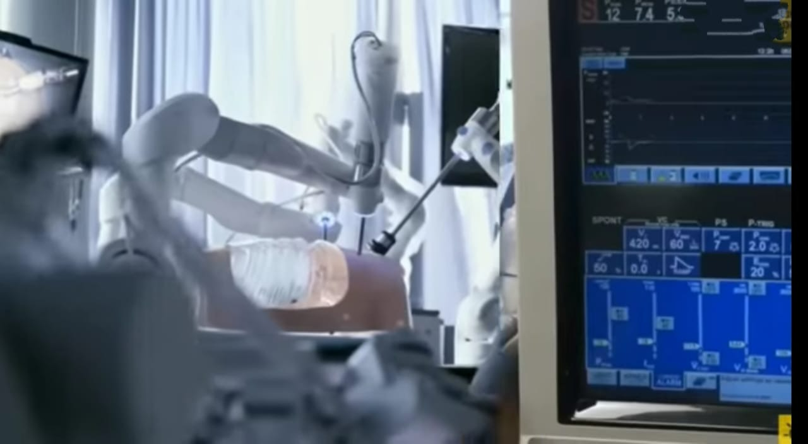
Uses of 5G:
Internet of things:
Robotics doctors:
Self Driving cars:
The robots to be able to interact with their environment in real-time, huge amounts of information will have to be transferred instantaneously with 5G Technology.
The Internet of Things refers to the rapidly growing 5G network of connected objects that are able to collect and exchange data in real time using embedded sensors.
5G networking allows cars to talk to each other and their environment, reducing the risk of accidents and allowing for far more efficient traffic patterns.

Slide 7
Advantages:
High resolution and bi-directional large bandwidth shaping.
Technology to gather all networks on one platform.
More effective and efficient.
Easily manageable with the previous generations.
Disadvantages:
The speed, this technology is claiming seems difficult to achieve (in future, it might be) because of the incompetent technological support in most parts of the world.
Developing infrastructure needs high cost.
Security and privacy issue yet to be solved.

Slide 8
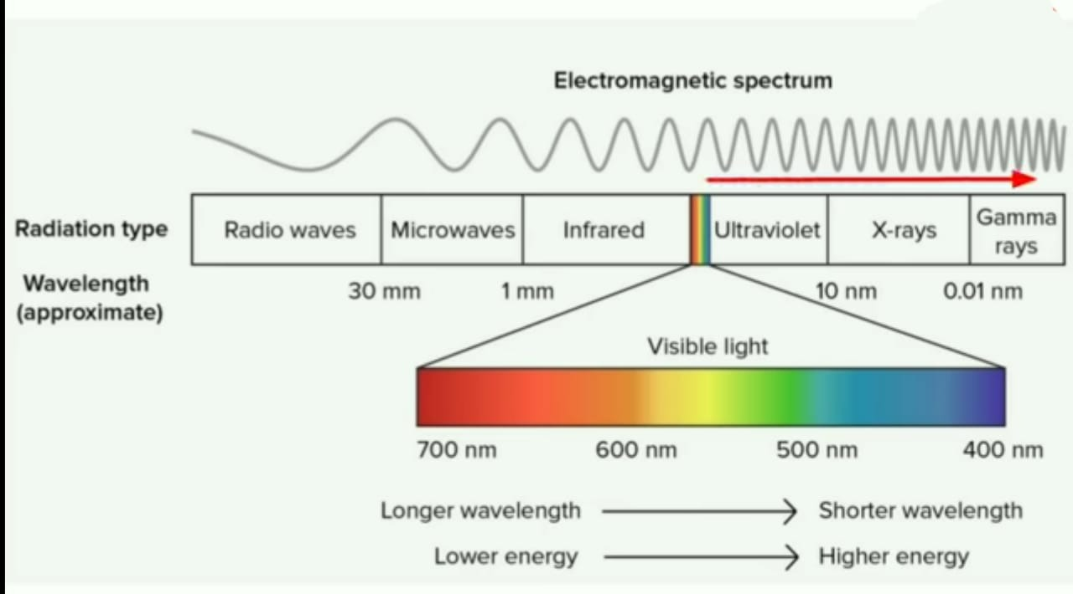
Is 5G is safe??
Yes, it is safe. Because 5G range is 100ghzs human body cannot effect in that frequency.

Slide 9
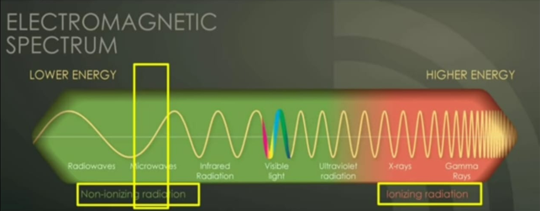
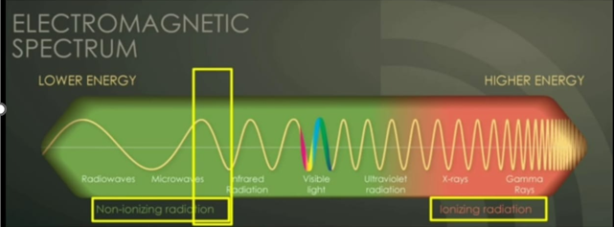
Frequency range that is used In 4G & 5G:
In 4G
In 5G

Slide 10


